Slide 1
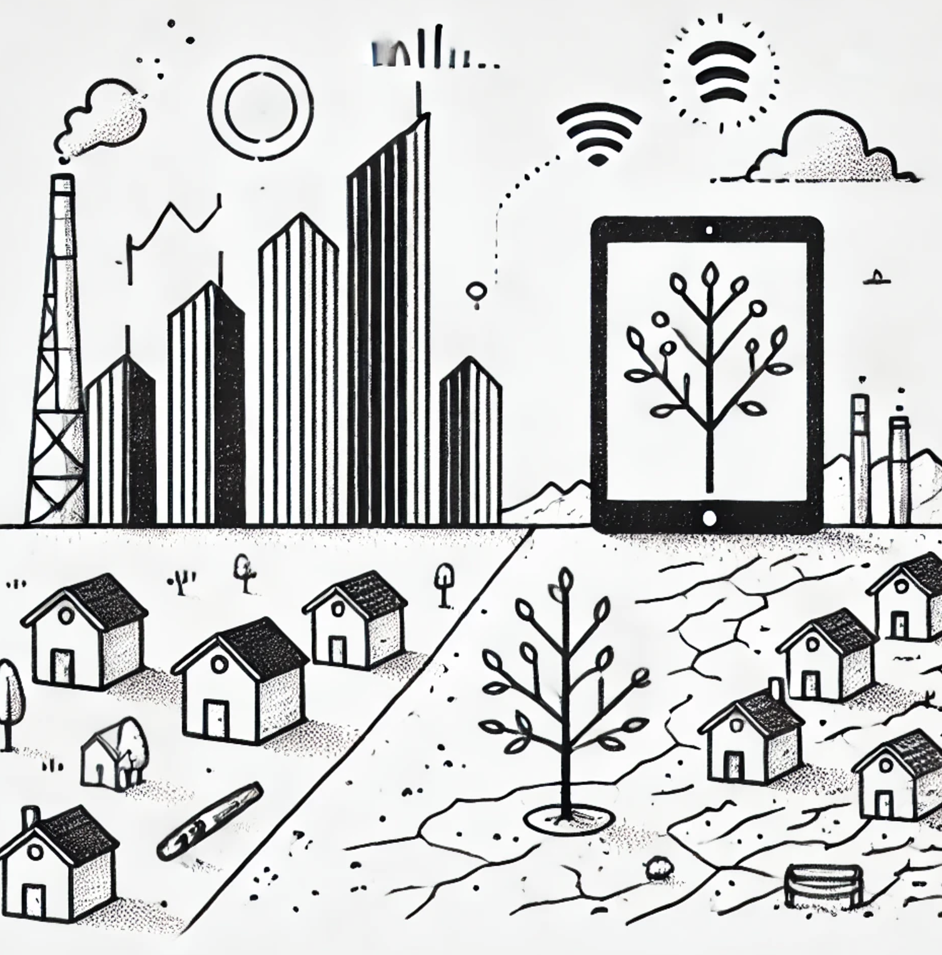
Technology, Growth and Inequality

Slide 2
Blessing and Curse
Better Prediction of Weather
Cancer
3...
Hallucination
Jailbreak
Fairness
Toxicity
lost of jobs
Curb against Discrimination
Access to digital technology
Economic Disparity
Sustainability
Environment Issues/ Carbon dioxide
Job Displacement
Technology Gap

Slide 3

Hallucination
Jailbreak
Fairness
Toxicity
lost of jobs
Curb against Discrimination
Access to digital technology
Economic Disparity
Sustainability
Environment Issues/ Carbon dioxide
Job Displacement
Technology Gap

Slide 4
Identifying Problems & Challenges
Fighting against discrimination (AI algorithmic bias: job recruitment, admissions, border control…)
Economic disparity & inequitable access to AI (loop: economic inequality → inequitable access → more disparity)
Labour market consequences & job displacement

Slide 5
Solution 1 (Carolina, Chi-min)
Educational toolkits to promote AI fairness in digital ethics
Game-based learning solutions targeting students, artists, researchers, engineers, policymakers…
Application: formal & informal education, training settings

Slide 6
Solution 2 (Sunghee, Ieva, Shaurya)
Capacity building
Social development training courses for AI researchers, designers & developers
AI technology training course for policy practitioners
- following up tech development & how it works

Slide 7
Solution 3 (Jake & Shaurya)
Participatory social agreement template
Terms on open data frameworks including data sovereignty, regulation of data transfer, storage, and localization
Terms on corporate social responsibility, extra-territorial obligations, and environmental protection (including outside the jurisdiction of the country)
Terms on labour and employment displacements, tax cuts, and algorithmic impact assessments (including remedies for AI harms and enforcements)

Slide 8
Solution 4 (Chang)
Retraining & re-skilling, through online lectures (i.e., Youtube)
Providing references and information regarding AI links to various informative machine-learning tutorial videos
Fairness toolbox for determining or analysing fairness and transparency of AI algorithms
Providing simple platform to develop AI software
Provide technical support for developing fair AI algorithms
→ Better access to equitable technology

Slide 9
Solution 5 (Kun, Chimin)
Produce, publish and disseminate academic research
Impact policymakers by engaging in policy advising
Promote interdisciplinary research & collaboration

